Slide 1

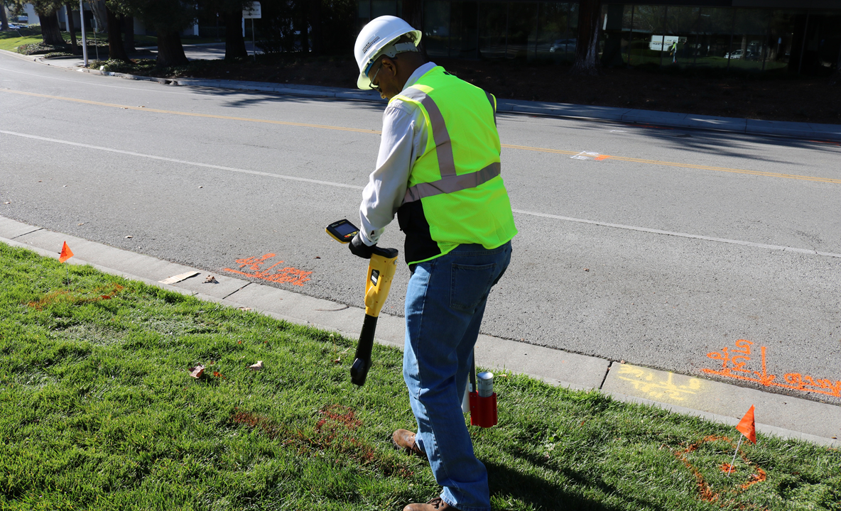
vLoc3 Series Utility Locators

Slide 2
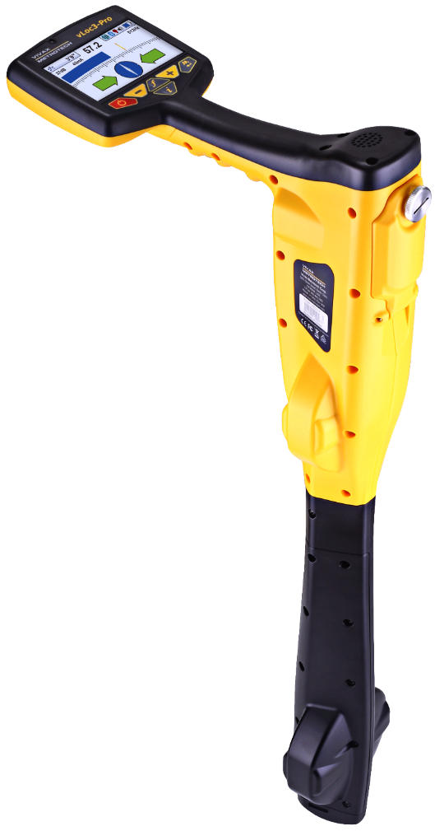
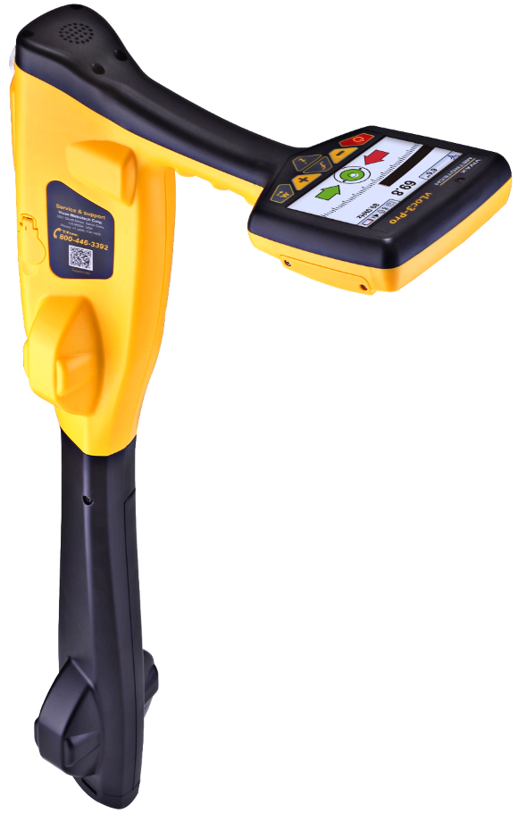
vLoc3 Receiver Range
vLoc3-Pro
vLoc3-5000
 | Vivax-Metrotech Corp. Confidential | 10/18/2016

Slide 3
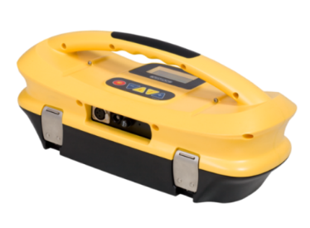
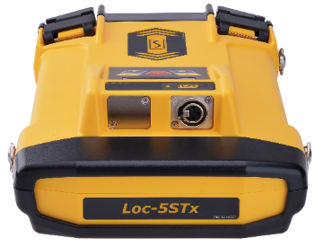
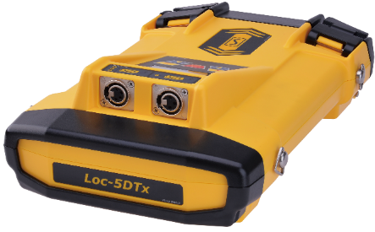
Loc Series Transmitter Range
10-Watt Transmitters
10-watts of power
Optional rechargeable battery
10-watts of power
Signal select frequencies
Optional rechargeable battery
Loc-10Tx
Loc-10TxSiS
5-Watt Transmitters
5-watts of power
Optional Li-Ion battery
5-watts pf power
4-Channel output
Optional Li-Ion battery
Loc-5DTx
Loc-5STx
 | Vivax-Metrotech Corp. Confidential | 10/18/2016

Slide 4
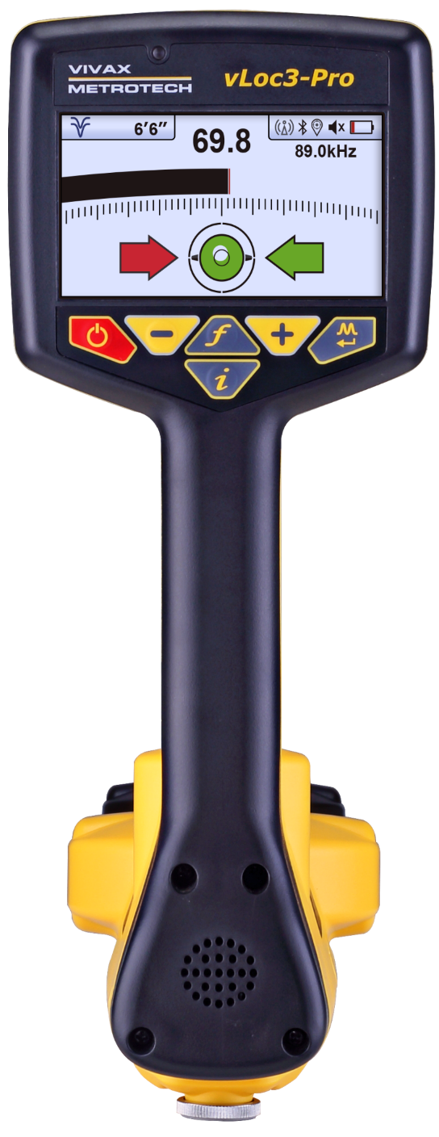
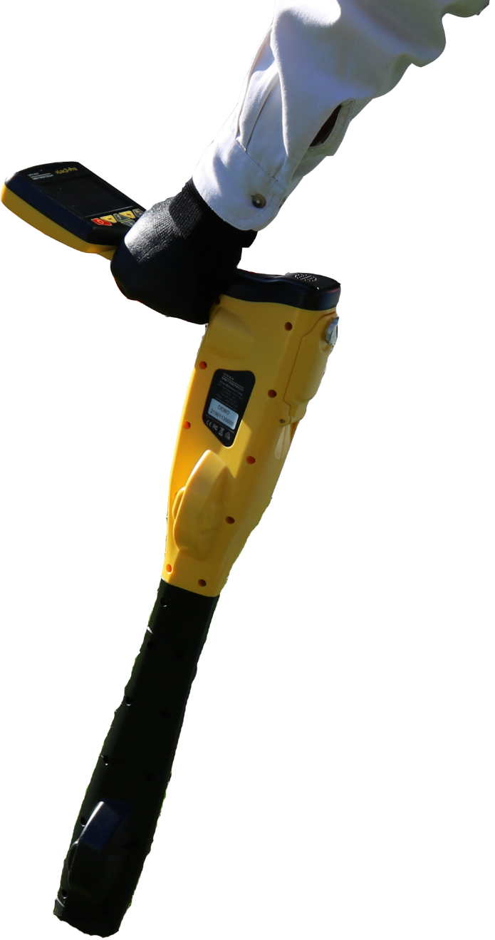
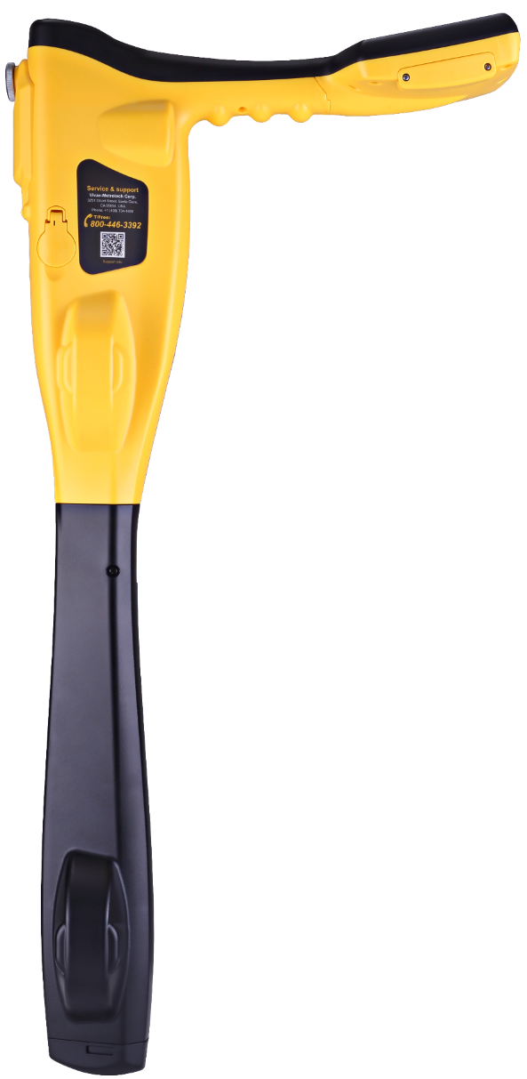
vLoc3 Series Weights and Dimensions
4.3” (10.9 cm)
480 x 272
26.6” (67.56 cm)
4.6 lb (2.1kg)
*with Li-Ion battery
 | Vivax-Metrotech Corp. Confidential | 10/18/2016

Slide 5
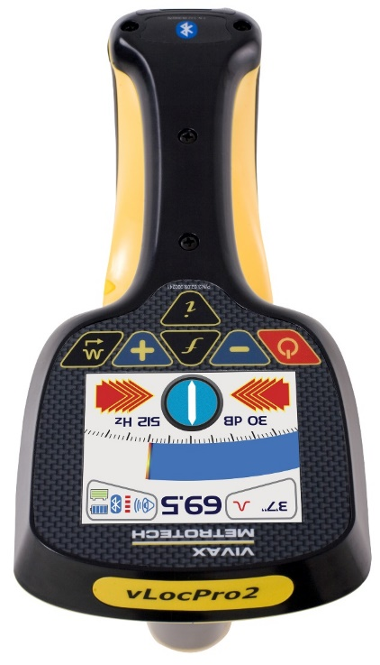
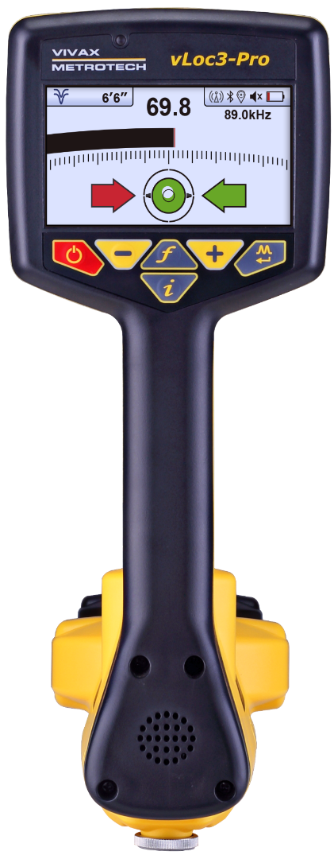
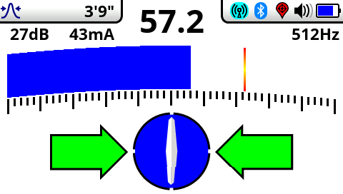
vLoc3-Pro Sticking with the fundamentals
Moving towards the future while still keeping the familiar classic feel.
vLocPro2
vLoc3-Pro
 | Vivax-Metrotech Corp. Confidential | 10/18/2016

Slide 6
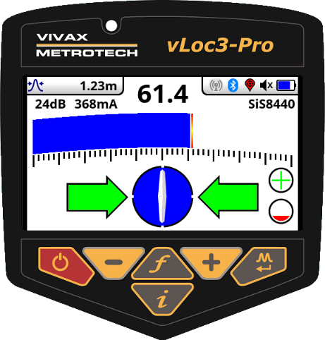
vLoc3-Pro Sticking with the fundamentals
Classic Locate Screen
Widely adopted internationally by locate professionals
Familiar locate screen for users on vLoc1 or vLoc2 series
Quick learning curve
Fast response over target lines
Highly visible, intuitive icons and colors
Simultaneous depth and current measurements
Classic locate modes with the addition of Omni directional mode
Instant distortion alert
 | Vivax-Metrotech Corp. Confidential | 10/18/2016

Slide 7

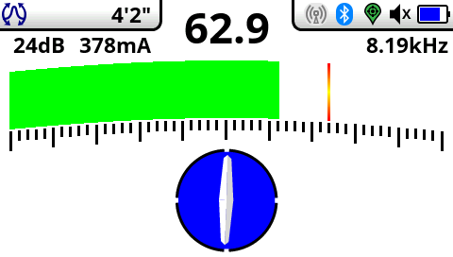
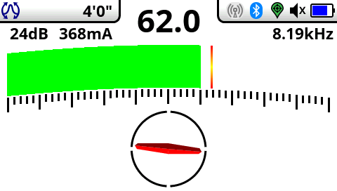
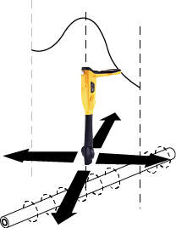
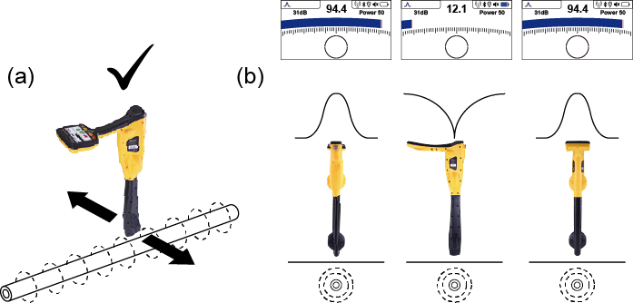
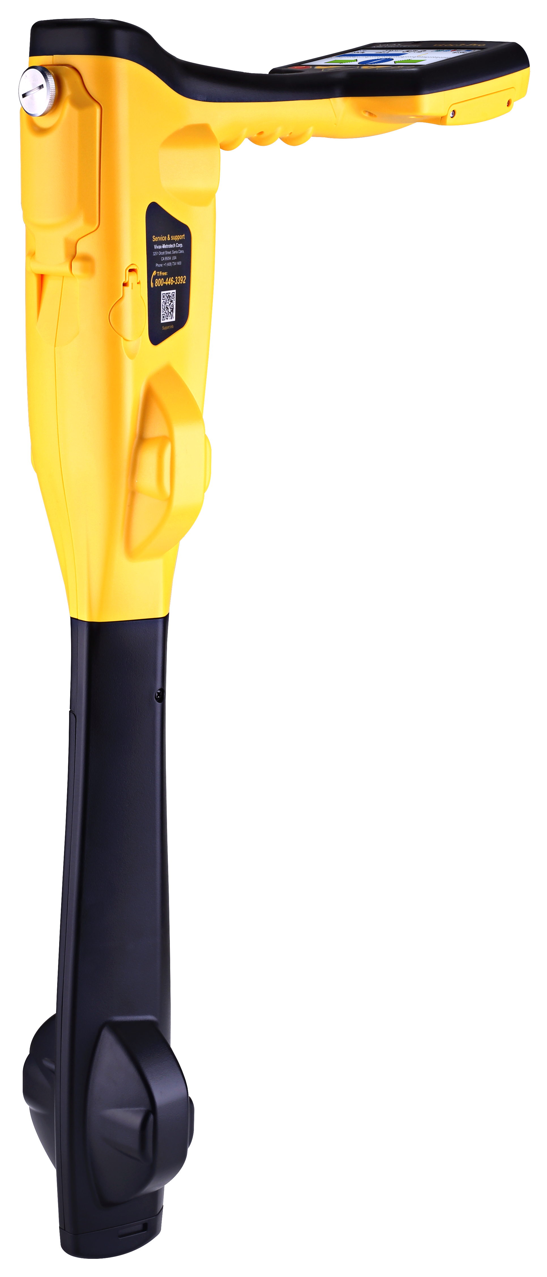
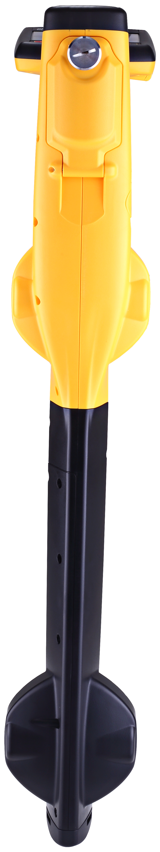
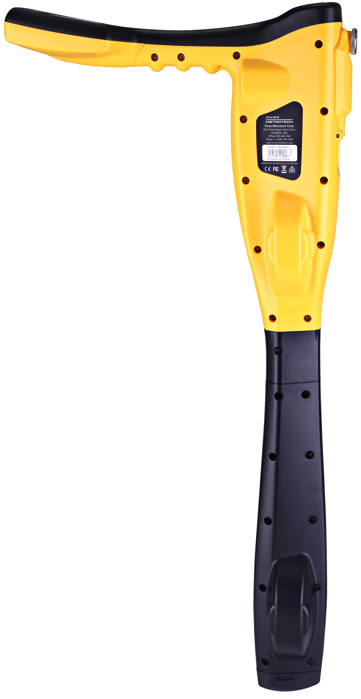
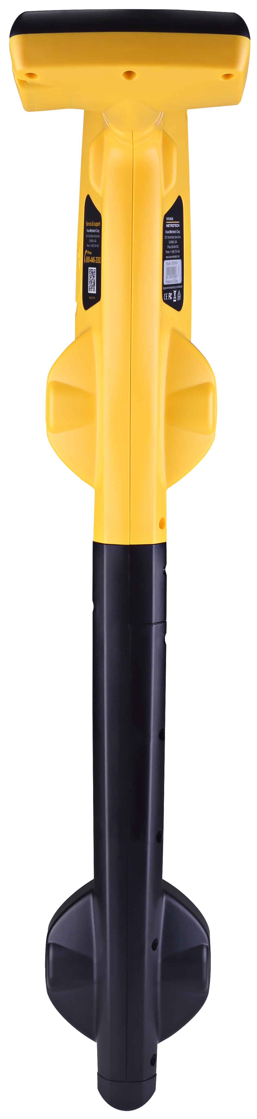
Omni Peak Response Mode
When you see the two double ended arrows around an icon, this means that the line is detectable regardless of locator blade orientation. It is very useful for quickly checking an area for buried lines using a grid search as one sweep will catch all locatable lines. In the classic screen the Omni feature is available in the “Peak” and “Broad peak” modes.

Slide 8


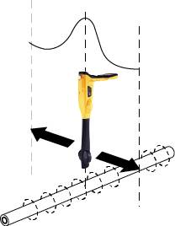
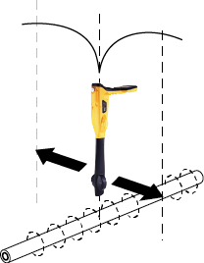
Classic Locating Modes (Response)
The vLoc3-Pro receiver has an array of six antennas, and these can be toggled through different configurations (modes) to provide different responses to the signals radiating from buried utilities. The modes are:
Peak with Arrows Response Mode
Delta Null
Omni Peak Response Mode
The peak with arrows mode operates in the same way as the peak mode. It gives the largest meter deflection when directly over the line. However, left/right indication arrows are also displayed. The arrows indicate the direction to move the receiver to locate the position of the buried line. Note: If the arrows indicated a different position for the cable than the peak bar graph position, this indicates the possibility of a distorted field. Check by taking a depth reading on the ground and then lift the cable locator a known distance such as 1m (3ft). If the depth does not increase by this amount it confirms a distorted field and the data should be treated with caution.
This uses dual vertical antennas. This has the advantage that it provides a sharper response than the “null” mode and is less affected by distorted fields. All other functions are the same as the “Null” mode.
When you see the two double ended arrows around an icon, this means that the line is detectable regardless of locator blade orientation. It is very useful for quickly checking an area for buried lines using a grid search as one sweep will catch all locatable lines. In the classic screen the Omni feature is available in the “Peak” and “Broad peak” modes.

Slide 9


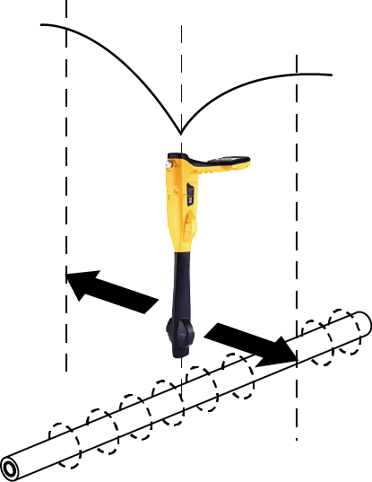
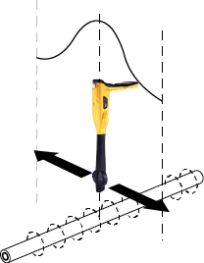
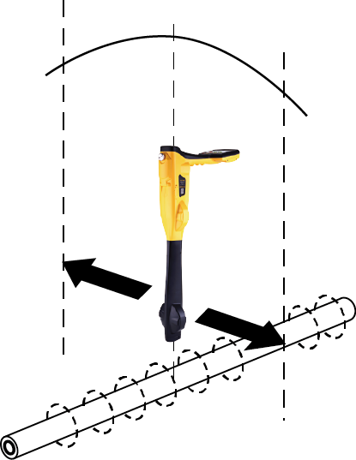
Classic Locating Modes (Response)
The vLoc3-Pro receiver has an array of six antennas, and these can be toggled through different configurations (modes) to provide different responses to the signals radiating from buried utilities. The modes are:
Null Mode
Peak Response Mode
Broad Peak Mode
This uses vertical antennas, and provides a minimum or “Null” response over the center of the buried line. The compass (line direction indicator) aligns itself parallel to the direction of the cable (available in Active modes) The null mode works well in uncongested areas but is more prone to inaccuracies due to the effects of field distortion. This effect can be utilised to detect the presence of distorted fields. Compare the locate position “Null Mode” with the position “Peak Mode”. If the two positions do not coincide, this indicates possible distortion. The greater the difference the greater the distortion. Left/right indication arrows are also displayed when in “Null” mode. The arrows indicate the direction to move the receiver to locate the position of the buried line.
Two horizontal antennas provide a “Peak” or maximum signal response over the center of the buried line. The compass (line direction indicator) aligns itself parallel to the direction of the cable (available in Active modes). This is an accurate method of the locating as both horizontal antennas are used to provide a clearly identifiable “Peak”. It is also less prone to the effects of signal distortion. A Peak Level Indicator is also provided on the bar graph. This indicates the largest signal detected allowing the user to quickly return to this point.
This uses a single horizontal antenna and provides a “Peak” or maximum signal response over the center of the buried line. The compass (line direction indicator) aligns itself parallel to the direction of the cable (available in Active modes). This gives a less defined peak than the twin horizontal antenna “Peak” mode – but is useful in some situations such as deep lines because using a single antenna has the effect of boosting the received signal.

Slide 10
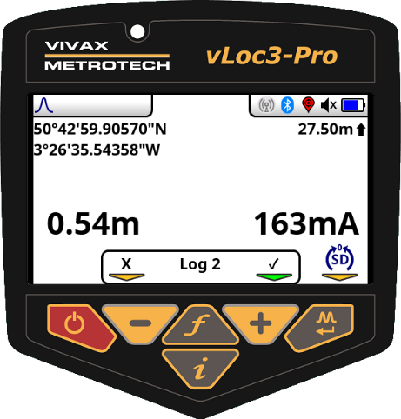
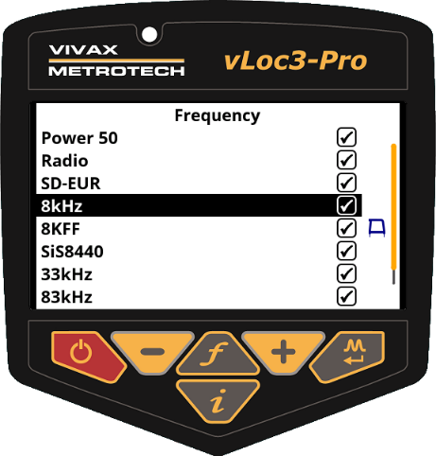
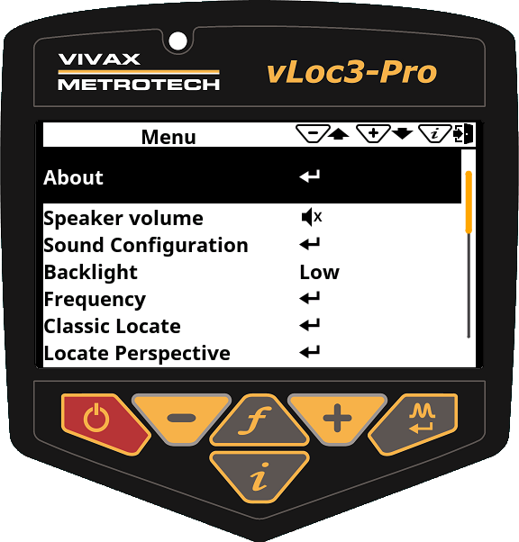
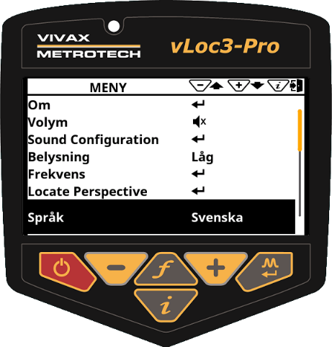
vLoc3 Series Locate and Settings Screens
Information
Frequency
Main Menu
Languages
Internal data storage
8GB of storage available
Wide variety available frequencies
User determines frequencies to use
User configurable options
Fleet management made easy
26 Languages available
Configured via MyLocator3
 | Vivax-Metrotech Corp. Confidential | 10/18/2016

Slide 11
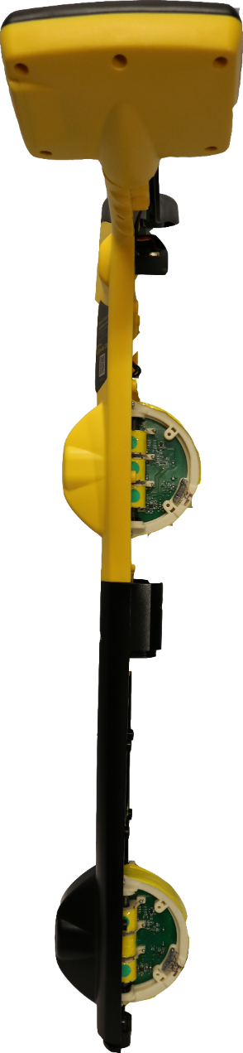
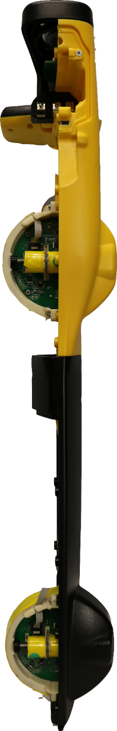
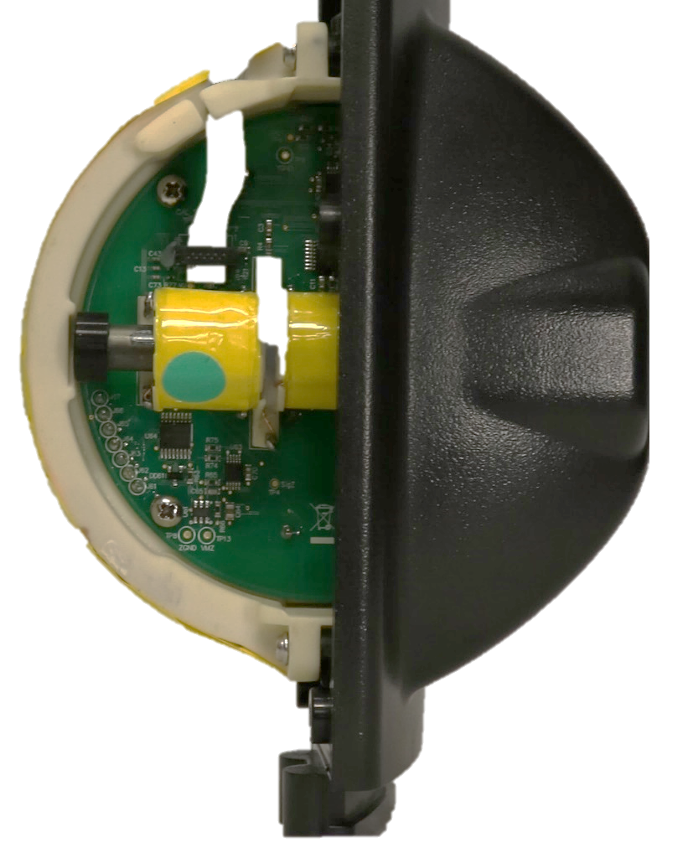
vLoc3 – Built for a 3D World
We live in 3D space. Magnetic fields are the same
2 sets of 3-tri axial sensors with multi-channel real-time processing.
Simultaneous measurement of:
  - Field Strength
  - Depth of cover
  - Current reading
  - Field distortion
 | Vivax-Metrotech Corp. Confidential | 10/18/2016

Slide 12
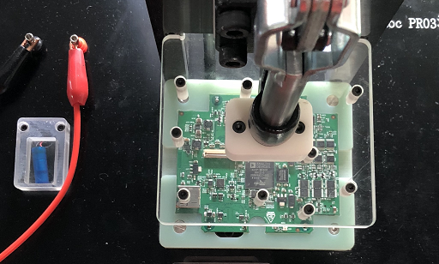
vLoc3 – The Locater Reinvented!
Continuous correction of depth reading during locate via accelerometer and gyroscope
Real Time Clock in order to provide proof of locate
Light Sensor to automatically control backlight and improve battery life
Vibration Motor – provides user warnings for various conditions: Top Signal greater than Bottom, Signal Overload, Excessive Tilt
 | Vivax-Metrotech Corp. Confidential | 10/18/2016

Slide 13
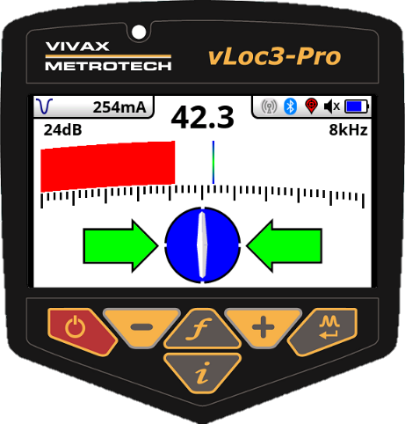
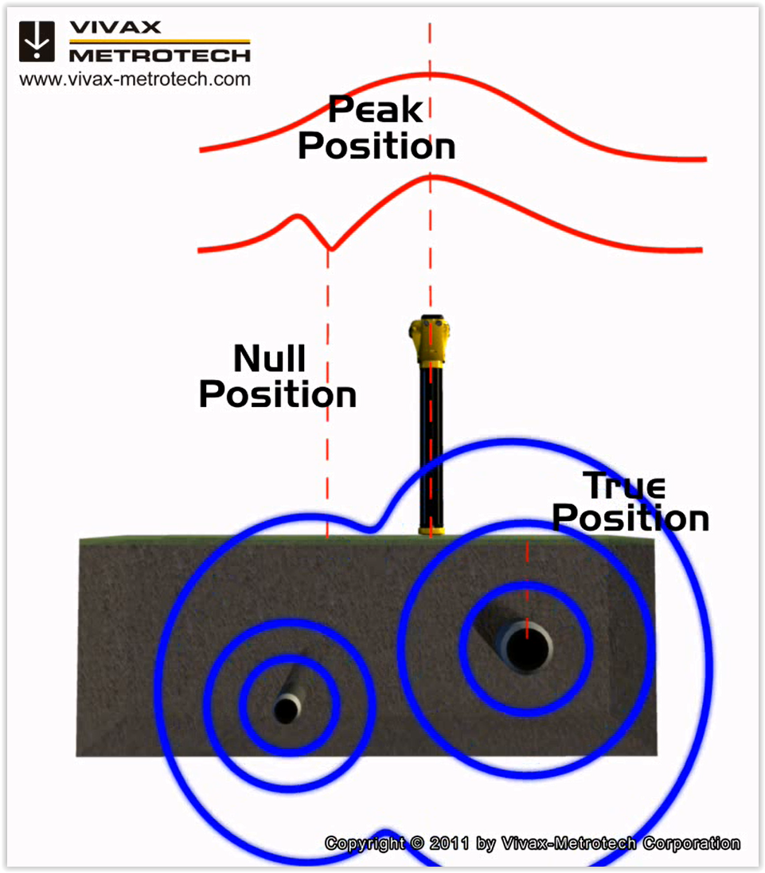
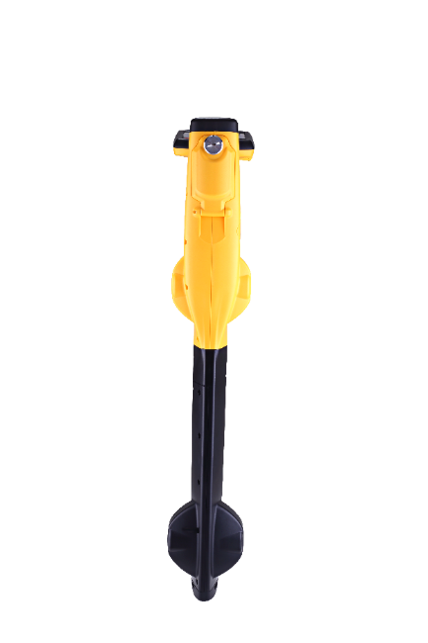
vLoc3-Pro – New Classic Screen
Signal Distortion - Classic Screen
The classic screen has an additional feature which indicates the level of signal distortion measured
Signal distortion is an intrinsic problem and is the result of additional currents flowing in the ground other than the outgoing signal wire
vLoc3-Pro Classic Screen gives an ‘on the fly’ indication of distortion as follows:
Green = clean locating conditions, very low distortion
Blue = indicates medium level distortion
Red = locate position indicates very high uncertainty
 | Vivax-Metrotech Corp. Confidential | 10/18/2016

Slide 14
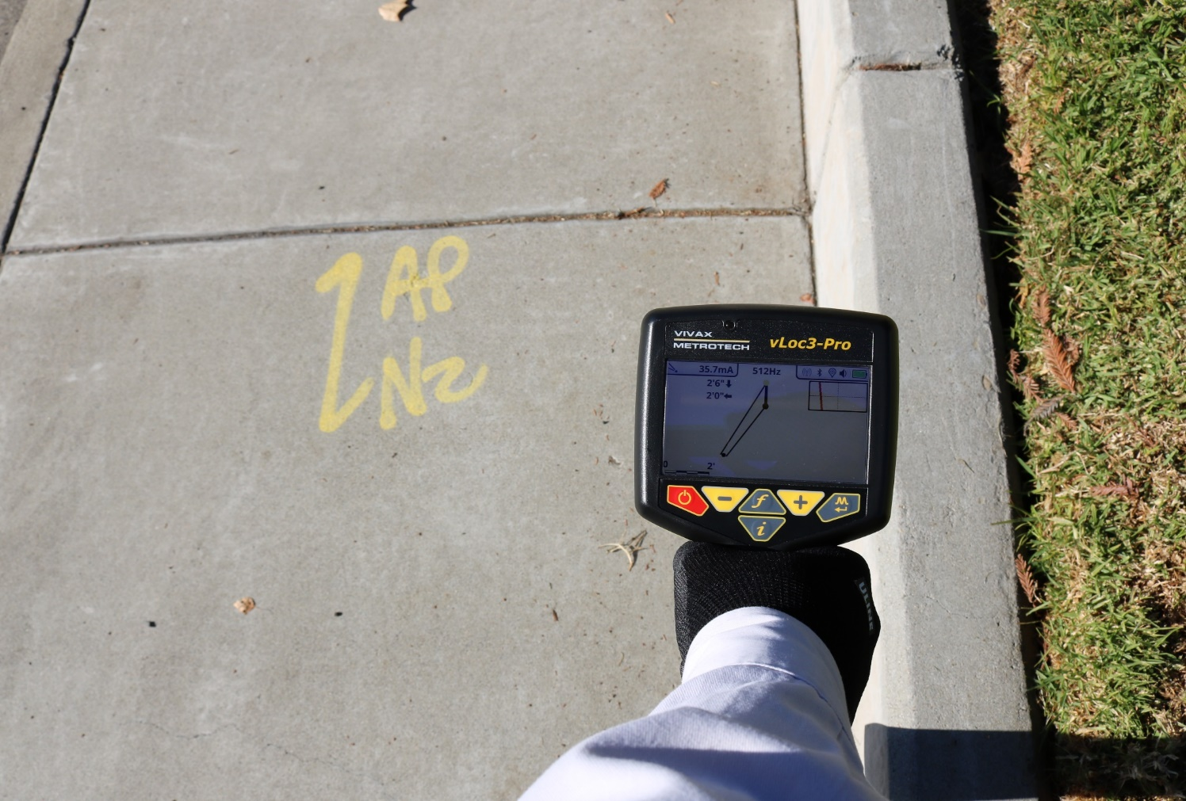
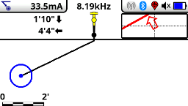
Vector Mode Screen – vLoc-5000 & Pro
Fully automatic screen, no gain control
Continuous display of depth and lateral offset readings under status bar continuous display of current.
In Vector locate mode, the uncertainty of locate is shown as a color coded circle:
Green = clean locating conditions, very low distortion
Blue = indicates medium level distortion
Red = locate position indicates very high uncertainty
 | Vivax-Metrotech Corp. Confidential | 10/18/2016

Slide 15
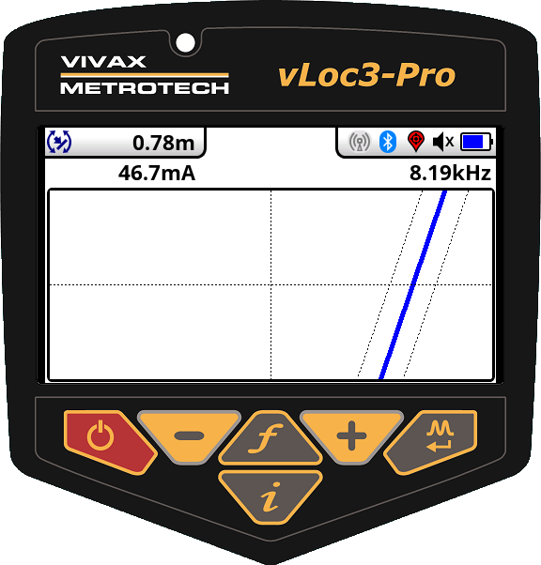
Plan View Mode Screen – vLoc3-5000 & Pro
Shows the relative orientation of the cable at any angle
Simple locate screen with no user controls beyond frequency selection
Continuous display of depth and current
Two adjacent lines indicate level of distortion the closer the lines the least distortion
Uncertainty of locate is color coded:
Green = clean locating conditions, very low distortion
Blue = indicates medium level distortion
Red = locate position indicates very high uncertainty
 | Vivax-Metrotech Corp. Confidential | 10/18/2016

Slide 16
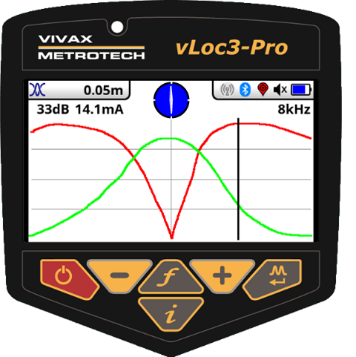
Transverse Graph Mode Screen – vLoc3-5000 & Pro
Plots peak and null transverse responses simultaneously
Provides an immediate measurement of signal distortion when the two responses do not align
Realtime visual comparison of distortion
 | Vivax-Metrotech Corp. Confidential | 10/18/2016

Slide 17
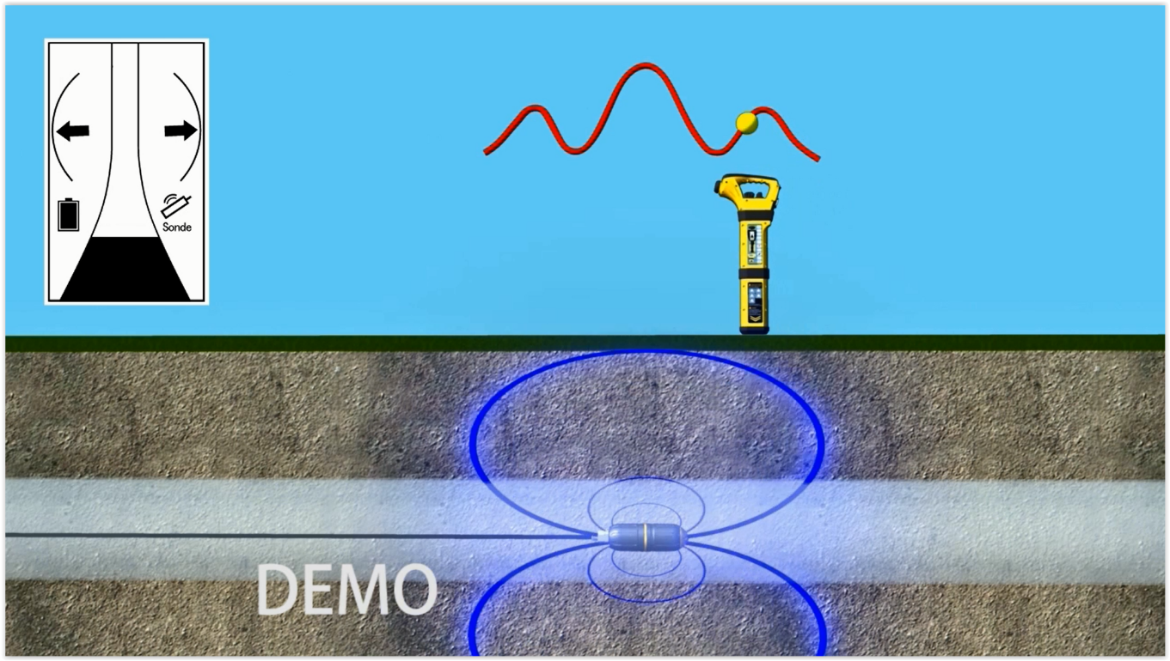
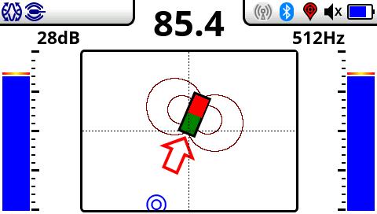
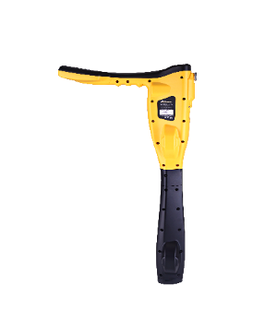
Sonde Mode Screen – vLoc3-5000 & Pro
Guidance arrow leads to the target sonde on a path that automatically aligns the user on the sonde axis
Red/green icon indicates the sonde position
Ghost positions are indicated by blue icon
Sonde can be in any orientation, even vertical
 | Vivax-Metrotech Corp. Confidential | 10/18/2016

Slide 18
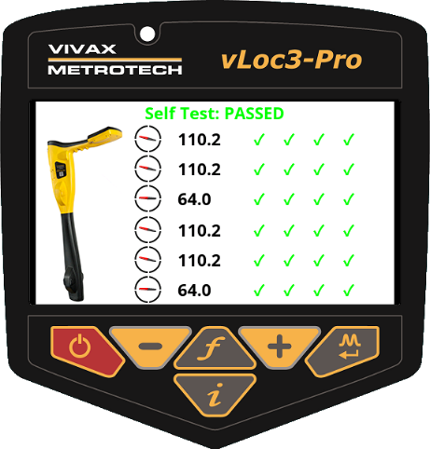
Calibration Verification/Self Test -vLoc3 Series
  High integrity self test that assures the sensors are operating with defined tolerances
  Result measurements are compared to the initial factory calibration tolerances
  Passing the self-test assures tat the locator is within factory recommended performance criteria
  Self-test results are logged to the SD Card
 | Vivax-Metrotech Corp. Confidential | 10/18/2016

Slide 19
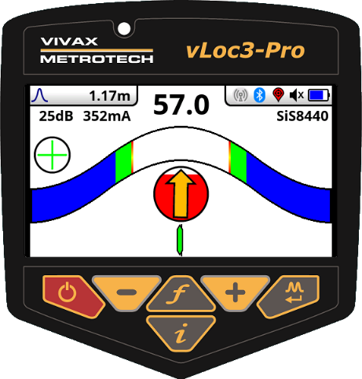
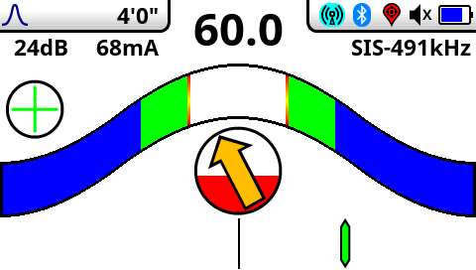
vLoc3-5000 - Classic Screen
“Curtains style” inward moving bar graph and peak indicator
Phase alert that a distorted field is detected
Easy to follow Left-Right proportional needle
Extended SiS frequencies of 491Hz, 982Hz, 8.44kHz, 9.82kHz, 35kHz
Internal GPS installed for mapping utilities
Bluetooth equipped for connection to VMMAP or external GPS devices
 | Vivax-Metrotech Corp. Confidential | 10/18/2016

Slide 20
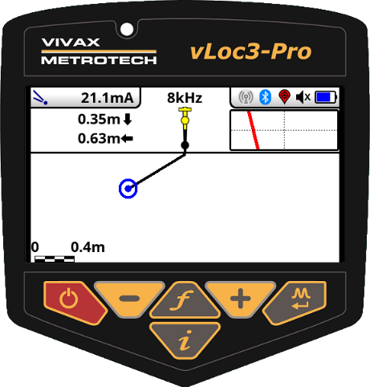
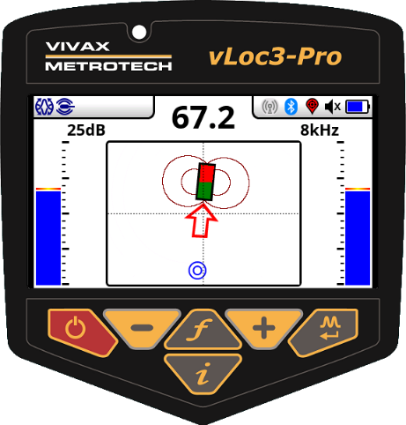
vLoc3-5000 Locate Screens
Vector mode
Plan view mode
Transverse graph mode
Sonde mode
 | Vivax-Metrotech Corp. Confidential | 10/18/2016

Slide 21
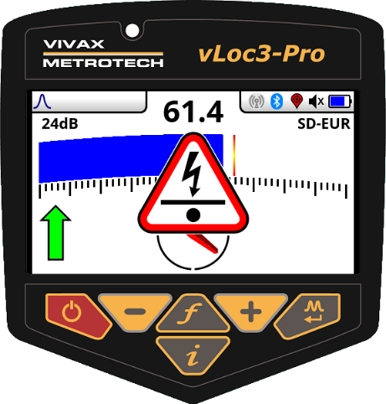




Warnings and Alerts - vLoc3 Series
Shallow depth warning - when utility is less than six inches deep
Overhead cable – possible distortion from above
Swing alert - when excessive movement of receiver is detected
Overload - indicates excessive signal (typically near a power transformer)
Warnings - causes vibration motor in handle to activate
Alerts - are logged in SD Card for future review
 | Vivax-Metrotech Corp. Confidential | 10/18/2016

Slide 22








vLoc3 Series Bluetooth Communication
Free VM-MAP smartphone/tablet mapping app
Ability to map using external devices
Available on all vLoc3 series of locators (standard on vLoc-5000)
 | Vivax-Metrotech Corp. Confidential | 10/18/2016

Slide 23

vLoc3 Series - data storage in the cloud
Free VM-MAP smartphone/tablet mapping app
Automatic upload of data to server for QA/QC, training or proof of data analysis
Real time transfer of data to server from the field
 | Vivax-Metrotech Corp. Confidential | 10/18/2016

Slide 24

vLoc3 Series - data storage in the cloud
 | Vivax-Metrotech Corp. Confidential | 10/18/2016

Slide 25

vLoc3 Series - data storage in the cloud
 | Vivax-Metrotech Corp. Confidential | 10/18/2016

Slide 26


